Slide 1
Designing and Developing Adjustable Online Lead Generation System
By Anton Ozolin, CWID 802177675

Slide 2
Contents
Introduction
Problem Statement
Proposed System
Development process comparing
Key Requirements

Slide 3
Introduction
Lead generation:
….
Process of stimulating and capturing interest in a product or service for the purpose of sale or any other desired outcome

Slide 4
Introduction (cont)
Online Lead Generation System
Web-Based Information system
Fill lead Form
Capture lead data
Browse captured leads

Slide 5
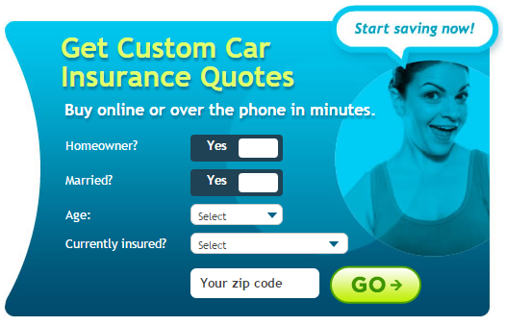
Problem Statement
Different markets need different lead structure

Slide 6
Proposed System
Adjustable Lead Generation System
If system administrator could adjust lead structure by him-self
The system can be applied to any market
A lot of potential clients

Slide 7
Development process comparing
Development process phases for existing customer
Customer Domain research
Customer Requirements gathering
Software Design
Software Development
….

Slide 8
Development process comparing (cont)
Database schema
Lead
quoteID
clientID
collegeID
Client
clientID
emailAddress
collegeID
stateID
grade
College
collegeID
collegeName
stateID

Slide 9
Development process comparing (cont)
Database schema
Lead
quoteID
clientID
Client
clientID
isHomeOwner
isMarreid
age
currentInsuranceCompany
zip

Slide 10
Development process comparing (cont)
Development for existing customer | Development for prospective customers
Customer Domain research | Multi Domain research
Requirements gathering | Requirements predicting
Software Design | Software Design
Software Development | Software Development

Slide 11
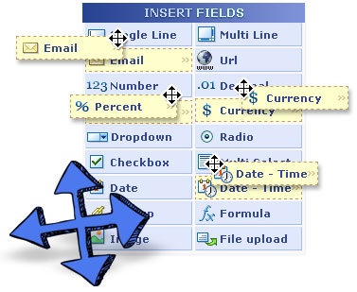
Key Requirements Predicted
System administrator must be able to:
Manage lead fields
Modify field position on a form

Slide 12
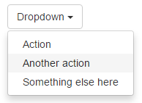
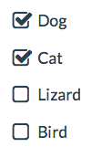
Key Requirement: Manage lead fields
LeadStructure
structureID
fieldID
fieldTypeID
labelText
isRequired
Four Field Types
Database schema
LeadTexbox
fieldID
placeholder
regularExpression
LeadRadio
fieldID
taxonomyID
LeadDropdown
fieldID
taxonomyID
placeholder
LeadChekbox
fieldID
taxonomyID

Slide 13
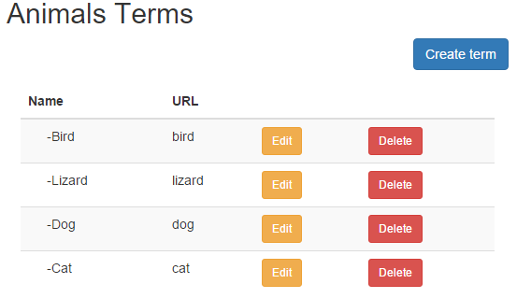
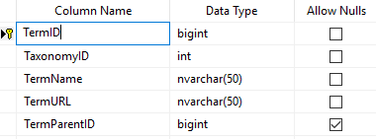
Key Requirement: Manage lead fields (cont)
Taxonomy Term Table Design

Slide 14
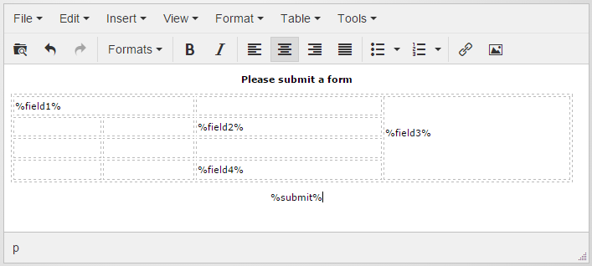
Key Requirement: Modify field position on a form
System administrator should be able to do it by him-self (without any coding)

Slide 15
Benefits
No need to perform advanced development
Can modify lead structure during exploitation
Can be used in small and new markets
Lower number of competitors => Higher Chances for Success

Slide 16
References
Lead Generation For Dummies (by Dayna Rothman) ISBN: 978-1-118-81617-2
TinyMCE WYSIWYG http://www.tinymce.com/

Slide 17
Thank you !

